Slide 1

Procedures – Modular Code
Writing our own custom commands
[Don’t need lab sheet until these are finished]

Slide 2
Procedures – Modular Code
Last Weeks
Variables : int, float
Boolean expressions : true or false
Loops : for (& while)
If conditional, elseif, else
Drawing commands : ellipse, line, point, rect etc
This Weeks Objectives
Procedures
Modularised code
Parameter passing

Slide 3
General Procedures
Procedures : block of code that performs a task,
e.g. draw a cross
Code runs when called as a command
Used to “package” a commonly used sequence of instructions (lines of code)
Code easier to design : top down design
avoid repetition
Make code more readable
Code easier to maintain
Better re-usability of code
In order to use procedures, must introduce setup()
Distinguish start code, from procedures
Open a sketch and add
Notes:
Unlike event procedures you have used up to this point, general procedures must be explicitly called.
You can create procedures or functions
Functions return a single value, procedures do not
Both functions and sub procedures can have arguments
You pass information into a sub procedure or a function through its arguments
Arguments must be typed in the prototype:
Private Sub DoSomething(Arg1 as String, Arg2 as Integer)
•••
End Sub
Functions are typed in addition to their arguments:
Private Function CalcInterest(Arg1 as Currency) As Currency
CalcInterest = <expression> 'return answer this way
End Function
Place functions in same place as event sub procedures

Slide 4
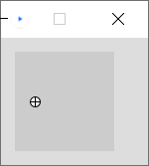
Draw a wheel
Draw Wheel :
Draw circle
Draw horizontal line
Draw vertical line
Introduce void setup() { }
Make Wheel procedure and call it from setup()

Slide 5
Open processing
//variables declared here [Global]– used throughout program
int x=20;
int y=50;
void setup() //program starts here
{
ellipse(x,y, 10,10); //draw a wheel
line(x-5,y, x+5,y); //draw a cross
line(x,y-5, x,y+5);
}
//we can add our procedures here
Write a wheel procedure and call it

Slide 6
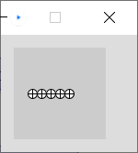
Row of Wheels: Top Down design
PseudoCode – English
Draw RowOfWheels
Repeat 5 times
Draw Wheel
move right
Draw Wheel :
Draw circle
Draw horizontal line
Draw vertical line
1st stage design
can convert 2nd stage to code
2nd stage design
Notes:
Problem decomposition

Slide 7
Parameters
Many commands we have used are built-in Procedures
void – doesn’t return a value
size( ), ellipse( ), point( ), line( ) are all Procedures.
Parameters are the information the procedure needs, the values we supply
ellipse(20,50,10,10);
Ellipse takes 4 parameters
(float x, float y, float width, float height)
Allows us to draw many ellipse(s) anywhere on the screen and control the width & height of each
write a circle procedure (draws any size circle, middle of screen) - What parameters should it take?
void square(int size) //float would also be fine
Parameters separated
by commas
Notes:
Processing – library of java procedures some coders have written for us to use

Slide 8
Passing Parameter values
local variable
100
void setup()
{
size(200,200);
circle(100);
circle(50);
circle(20);
}
void circle(float size)
{
ellipse(100,100,size,size);
}
size
100

Slide 9
Passing Parameter values
50
void setup()
{
size(200,200);
circle(100);
circle(50);
circle(20);
}
void circle(float size)
{
ellipse(100,100,size,size);
}
size
50

Slide 10
Passing Parameter values
20
void setup()
{
size(200,200);
circle(100);
circle(50);
circle(20);
}
void circle(float size)
{
ellipse(100,100,size,size);
}
size
20

Slide 11
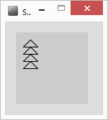
More Parameters
int x= 10;
void setup()
{
for(int y=20; y<60; y=y+10)
{
triangle(x, y, 20);
}
}
void triangle(int x, int y, int size)
{
float triHeight = size/2;
line(x,y, x+size,y);
line(x,y, x+triHeight,y-triHeight);
line(x+triHeight, y-triHeight,x+size,y);
}
What will the effect be?
x,y
Notes:
Nested loop, x is 10, y is changing first (20,30,40,50)

Slide 12
More Parameters
void setup()
{
for(int x=10; x<60; x=x+20)
{
for(int y=20; y<60; y=y+10)
{
triangle(x, y, 20);
}
}
}
void triangle(int x, int y, int size)
{
float triHeight = size/2;
line(x,y, x+size,y);
line(x,y, x+triHeight,y-triHeight);
line(x+triHeight, y-triHeight,x+size,y);
}
What will the effect be?
inner loop, x=10
x,y
Notes:
Nested loop, x is 10, y is changing first (20,30,40,50)

Slide 13
Add Parameters to Wheel
What does it need to know to draw a wheel?
void wheel()
{
ellipse(x,y, 10,10);
line(x-5,y, x+5,y);
line(x,y-5, x,y+5);
}

Slide 14
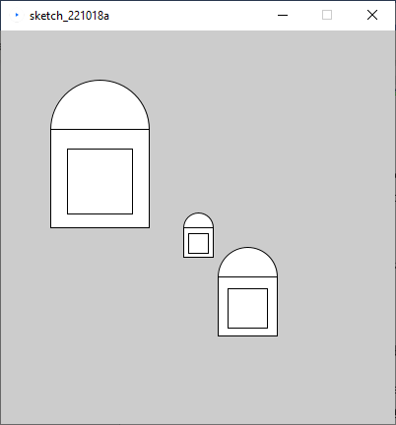
Pair Programming exercise Lab Sheet
Code this
must use at least one Procedure with parameters

Slide 15
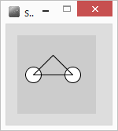
Motorbike – different sizes?
Simple motorbike at position(x,y) of any size
PseudoCode – English
Draw motorbike(x,y,size)
Draw left wheel - circle(x, y, size/3)
Draw right wheel- circle(x+size, y, size/3)
Draw triangle(x, y, size)
size
Notes:
Imporve our motorbike procedure

Slide 16
Solution 1
void setup()
{
motorbike(20,50,60);
}
void motorbike(int x, int y, int size)
{
circle(x,y,size/3);
circle(x+size,y,size/3);
triangle(x,y,size);
}
void circle(int x,int y, int size)
{
ellipse(x,y,size,size);
}
20
50
60
void triangle(int x, int y, int size)
{
float triHeight = size/2;
line(x,y,x+size,y);
line(x,y,x+triHeight,y-triHeight);
line(x+triHeight,y-triHeight,x+size,y);
}

Slide 17
Solution 2
void setup()
{
motorbike(20,50,60);
}
void motorbike(int x, int y, int size)
{
circle(x,y,size/3);
circle(x+size,y,size/3);
triangle(x,y,size);
}
void circle(int x,int y, int size)
{
ellipse(x,y,size,size);
}
20
50
60
void triangle(int x, int y, int size)
{
float triHeight = size/2;
line(x,y,x+size,y);
line(x,y,x+triHeight,y-triHeight);
line(x+triHeight,y-triHeight,x+size,y);
}
20
50
20
2 local variable called x,
2 local variables called y
2 local variables called size

Slide 18
Solution 3
void setup()
{
motorbike(20,50,60);
}
void motorbike(int x, int y, int size)
{
circle(x,y,size/3);
circle(x+size,y,size/3);
triangle(x,y,size);
}
void circle(int x,int y, int size)
{
ellipse(x,y,size,size);
}
20
50
60
void triangle(int x, int y, int size)
{
float triHeight = size/2;
line(x,y,x+size,y);
line(x,y,x+triHeight,y-triHeight);
line(x+triHeight,y-triHeight,x+size,y);
}
80
50
20
2 local variable called x,
2 local variables called y
2 local variables called size

Slide 19
Solution 4
void setup()
{
motorbike(20,50,60);
}
void motorbike(int x, int y, int size)
{
circle(x,y,size/3);
circle(x+size,y,size/3);
triangle(x,y,size);
}
void circle(int x,int y, int size)
{
ellipse(x,y,size,size);
}
20
50
60
20
50
60
void triangle(int x, int y, int size)
{
float triHeight = size/2;
line(x,y,x+size,y);
line(x,y,x+triHeight,y-triHeight);
line(x+triHeight,y-triHeight,x+size,y);
}
30
2 local variable called x,
2 local variables called y
2 local variables called size
1 local variable called triHeight

Slide 20
Procedures Parameters, Global Vars
Procedures should always be passed ALL the information they need to work
Do NOT use global variables within Procedures!
Use parameter(s) instead
Local variables die off at end of procedure – efficient use of memory
Encapsulation
Takes care of itself
Easy to reuse in another program
int size=40; //global variable
void triangle(int x, int y) //parameters
{
float triHeight = size/2; //local variable
line(x,y,x+size,y);
line(x,y,x+triHeight,y-triHeight);
line(x+triHeight,y-triHeight,x+size,y);
}
Bad Programming

Slide 21
Top Down Design
Also known as Stepwise Refinement, Problem Decomposition
Breaking down a problem into subproblems – recursively
Refine(problem)
If problem can be stated (unambiguously) as code
done – keep statement
Else
{
take problem and break into set of subproblems
For each subproblem
Refine(subproblem)
}
Define program in terms of headings
Take each

Slide 22
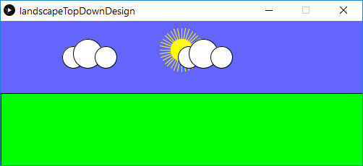
Exercise: Landscape, 3 levels
Draw Land
Fill(green)
Draw rectangle
Draw Sky
Blue background
Sun
Cloud(position 1)
Cloud(position 2)
Sun
Fill (yellow), stroke
Rays – for loop
circle
Landscape
Draw Sky
Draw Land
Cloud(x, y)
Fill(white)
circle(x,y,medium)
circle(x+?,y-?,large)
circle(x+?,y-?,small)
Notes:
Have a go

Slide 23
Summary
Modular code – code blocks become procedures
Parameters – passing values
Local variables, global variables
Abstract code
Top down design

